Slide 1
Week 3: Relativity
All observers are subject to the same laws of nature regardless of their frame of reference.

Slide 2
Outline
Frame of reference
Special relativity
General relativity

Slide 3
Frames of Reference
Impact how we perceive things.
Person throwing a coin in the air while travelling on a train sees the coin rise and fall vertically whereas an observer on the ground may see the coin travel forward in an arc, depending upon the velocity.
The path of travel by the coin differs according to the frame of reference of the observer.

Slide 4
Frames of Reference
Throwing a baseball
Velocity appears fixed when thrown between two stationary observers (e.g. 20km/h)
If thrown in the direction of travel on a moving train at 100km/h the velocity would appear to be 120km/h to a ground observer.
If thrown on the same moving train but in the opposite direction of travel the ball will appear to travel at 80km/h to an observer on the ground
If you substitute a beam of light for the ball, the velocities could not be added up because light cannot travel faster than “c” (3.0 X 10e8).

Slide 5
Paradox of Natural Laws?
Velocities can be added for objects travelling less than the speed of light but what about objects approaching c?
Suggests that laws of nature (Newton’s laws of motion etc.) are not correct in some situations
How can this paradox be resolved?

Slide 6
Three possible solutions…
The laws of nature are not the same in all frames of reference (philosophically difficult)
Maxwell’s equations are applicable in every situation and that the speed of light may depend upon the source (Experimental evidence refuted this)
Our ideas about the addition of velocities is incorrect (maybe not exactly the way we think?)

Slide 7
Principle of Relativity: Paradox Resolved
Albert Einstein considered the apparent contradiction between Newton’s Laws and Maxwell’s equations (four fundamental laws of electricity and magnetism-see next slide)
Einstein resolved the paradox through the concept of “Relativity”
Every observer is subject to the same natural laws within their frame of reference

Slide 8
Maxwell’s Equations
Scottish physicist John Clerk Maxwell studied electricity and magnetism and established the mathematical basis for the concept that they are different forms of the same force-electromagnetism.
Built on the work of Coulomb when combined with Lorentz’s force law, these differential equations are summarised below in words:
Coulomb’s Law: like charges repel and unlike charge attract
Magnetic monopoles do not exist in nature
Magnetic phenomena can be produced by electrical effects
Converse of #3-electrical phenomena may be produced by magnetic effects

Slide 9
Relativity
“Every observer must experience the same natural laws”
Relativity was published in two parts”
Special Relativity (1905)-applies to frames of reference in uniform motion to one nother
General Relativity (1915)-accelerating frames of reference
The speed of light, c (3.0 X 10e8) remains the same in all frames of reference

Slide 10
Special Relativity
Less complex mathematically than General Relativity (non-accelerating FoR)
Number of predicted effects
Time Dilation
Length Contraction
Mass

Slide 11
Time Dilation
Time Dilation
Moving clock appears to tick more slowly

Slide 12
Stationary versus Moving Light Clock
See Figure 7-3 for a demonstration of how time dilation is calculated using Pythagorean theorem (pgs 154-155 text)

Slide 13
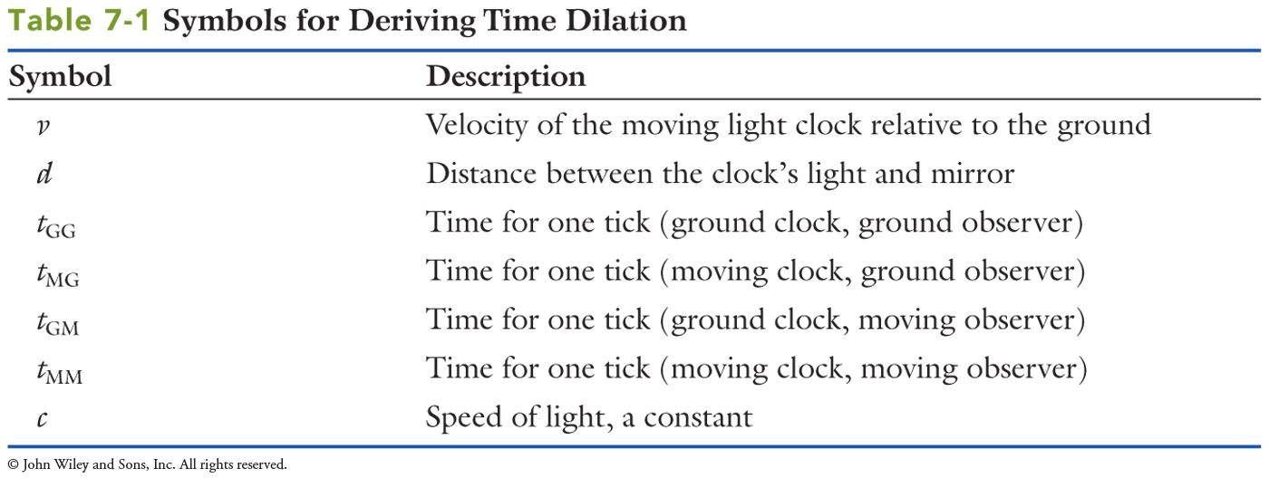
Symbols for Deriving Time Dilation (from Trefil and Hazen 2013)

Slide 14
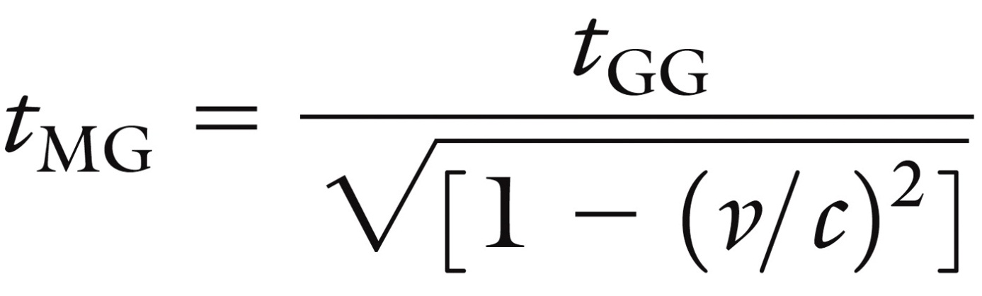
Calculation of Time Dilation
Time passes at the same speed for a ground based clock and a ground-based observer or for a moving clock and a moving observer (same velocity)
For a stationary ground-based observer a moving clock time is equal to distance divided by velocity (in this case c or the speed of light)
t_{GG}=d/c
Therefore the distance travelled by light during one “tick” of the clock is described by the following equation:

Slide 15
Stationary versus Moving Light Clock
See Figure 7-4

Slide 16
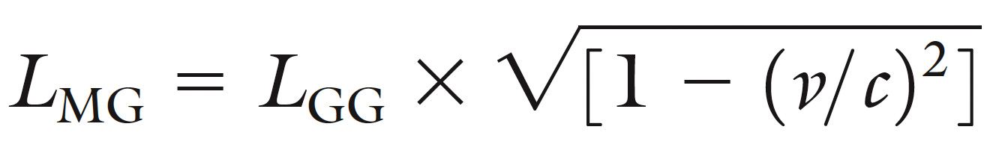
The Impact of Relativity on Length of Objects
As an object approaches the speed of light it appears shorter to a ground-based observer
As in time dilation, the Lorentz factor is used to correct for relativistic effects. If velocities much lower than the speed of light and substituted in for v, it can be seen that there is little effect on L_{MG}

Slide 17
Impact of Relativity on Resting and Moving Spaceship
See Figure 7-5

Slide 18
What does relativity tell us about adding velocities?
The addition of small velocities is valid (ball thrown on moving train) however at or near the speed of light this is no longer valid

Slide 19
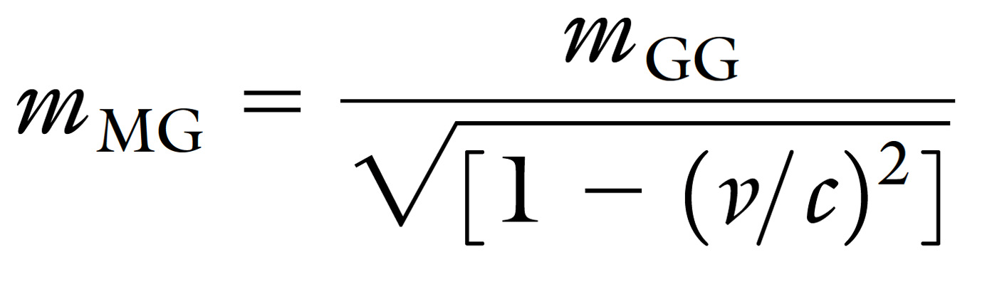
What is the effect of Relativity on mass?
Mass is lowest for stationary objects
As objects travel closer to the speed of light their mass increases as described by the following formula:

Slide 20
Mass and Relativity
The effect of relativity on perception of mass results in some further considerations
Time, distance and mass are all dependent on frames of reference
The speed of light is constant in all frames of reference (FoR)
The first law of thermodynamics is constant regardless of frames of reference
If mass depends upon the FoR how can kinetic energy (E= m x v²) follow the law of conservation of energy?
Einstein demonstrated that the amount of energy in any object is equal to its mass times a constant –in this way all objects contain a rest energy
The equation for rest energy is: E = m x c² were c is the speed of light
Mass can be converted into energy and vice versa

Slide 21
General Relativity-Relativity for ALL Frame of Reference
See Figure 7-7
Figure 7-8, 7-9 and 7-10
These discuss the prediction of General Relativity:
Gravitational bending of light
Planetary orbit
Gravitational Redshift

Slide 22
Predictions of General Relativity
Gravitational bending of light proposes that light can be bent by warped space near strong gravitational centres. This idea was successfully test during a solar eclipse in 1919 (after the publication of GR)
Planetary Objects: Both Newton and Einstein proposed that the orbits of planets can be modified slightly in response to other large planets. Einstein’s prediction of changes in Mercury’s orbit (due to warped space) were exactly correct
Gravitational Redshift: As radiation moves in a gravitational field it must lose energy but since the speed of light is a constant the loss of energy appears as a shift in light emission (decrease in wavelength. In this way lights on earth will appear red-shifted if observed from space. Conversely, light shining on earth from space will appear blue-shifted.

Slide 23
Relativism and our Daily Lives
See Figure 7-11
Global Positioning Satellites employ relativistic corrections to the atomic clocks onboard to maintain accuracy to the 13 decimal places required to give ground-based observers correct position information (in relation to the moving, space-bound satellites.
Totally cool!

